Slide 1

Lecture 15: Inference in DBNs
Artificial Intelligence (CS 131)

Slide 2
Review: DBN Transition Model
Rain_{t-1}
Rain_{t}
Rain_{t+1}
Umbrella_{t-1}
Umbrella_{t}
Umbrella_{t+1}
Probability that system state will change over time
Stationary assumption: probabilities are the same for all times t
Markov assumption: state X_{t} is conditionally independent of all other states, given evidence about those that influence it (by the Markov assumption)
For a 1st-order model, this means:

Slide 3
Review: DBN Observation Model
Rain_{t-1}
Rain_{t}
Rain_{t+1}
Umbrella_{t-1}
Umbrella_{t}
Umbrella_{t+1}
Probability of observation, E_{t}, given current state, X_{t}
E_{t} is conditionally independent of everything else, given evidence about the local state:

Slide 4
Doing Forward Inference
Both filtering and prediction can be treated as examples of the same basic recursive updating procedure
Say we are at time t and get new observation, e_{t+1}
We can determine the probability of the next state:
(We get 2nd line by Bayes’ Rule, and 3rd by Markov Property)
Normalization constant:

Slide 5
Components of Prediction/Filtering
First part of equation is simply the observation model
The second part is a one-step prediction of the state at time t + 1, given everything observed up to time t

Slide 6
Computing the Necessary Prediction
We condition on all possible values of current state (X_{t}) to get the prediction of the next state (X_{t+1}) :
(Where the simplification in the last line is a result of using the Markov Property again)

Slide 7
Belief Updates
Now, we simply have to plug in our current belief (our distribution over states at the last time-step, on the right), to give us our prediction (on the left)
If we haven’t computed and stored this belief already, then we would have a recursive situation
The formula at time t, to get probability of state at (t + 1), is written using the same filtering equation, but using values for prior state
To get that, we can do the same thing…

Slide 8
An Example
R₀
R₁
R₂
R_{t-1} | P(R_{t})
T | 0.7
F | 0.3
P(R₀) = 0.5
U₁
U₂
R_{t} | P(U_{t})
T | 0.9
F | 0.2
We have Rain/Umbrella Network with an observation history where an umbrella is observed (U_{t} = T) for two days
Want to know probability of rain on the last day (R₂ = T) given this observation-history

Slide 9
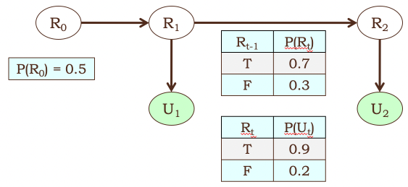
Umbrella Example, continued
Want probability of rain, given umbrellas on both days
Can use the conditionalized version of Bayes’ Rule (found in text as equation 12.13, page 399):

Slide 10
Umbrella Example, continued
Now, since the observation U₂ is independent of everything else given its parent state, R₂:

Slide 11
Umbrella Example, continued
We can then get the probability of rain at day 2, given an umbrella at day 1, by conditionalizing on prior rain values:

Slide 12
Umbrella Example, continued
Again, the network structure tells us that R₂ is independent of all prior information, given the previous state, R₁:

Slide 13
Umbrella Example, continued
Now, we can use Bayes’ Rule again to get P(r₁|u₁) = x, and the other value, P(¬r₁|u₁), is simply (1 – x):

Slide 14
Umbrella Example, continued
Last, we can get P(r₁) by normalizing again, using all possible values of the previous state, R₀:

Slide 15
Umbrella Example, continued
Now we solve for P(r₁), again by conditionalizing:

Slide 16
Umbrella Example, continued
And plug in that value to solve for P(r₁|u₁):

Slide 17
Umbrella Example, continued
Then plug in that number to solve for P(r₂|u₁, u₂):

Slide 18
Umbrella Example, continued
Finally, solve for normalization constant α (in basically the same way, details skipped here) to get the final answer:

Slide 19
Recursion in Filtering/Prediction
Here, for sake of example, we worked out the full calculation from the most recent observation, e_{t+1}, all the way back to the initial state distribution, P(X₀)
In doing so, clearly, the amount of computation required is directly proportional to the size of the BN structure at any stage of the problem, multiplied by the length of the time horizon (t + 1)
To avoid requiring possibly unbounded memory, however, we use the basic definition of the update:

Slide 20
Continual Updates for Filtering/Prediction
The update for time (t + 1) simply requires the results of the same calculation for the prior step
Thus, we retain this belief-state as we move through time, updating it at each step, and doing all of our filtering and one-step prediction in a constant amount of memory space and processing time

Slide 21
Complexity of Temporal Inference
In general, for basic updating via filtering or one-step prediction, we get a linear amount (O(n)) of work in the size of the overall one-stage network
For backwards inference, this will also be linear in the time-horizon, O(t), for a total of O(n * t)
Even very long-range updates can be done relatively efficiently
For more complex inference problems, like the most likely event-sequence, the algorithms are more complex, but involve the same basic manipulations, and can also be made linear in the length of the sequence

